Slide 1
Hands-on Machine Learning

Slide 2
Info
This session is for complete beginner to ML
You will get overview of what is ML and problems it can solve
At end of this session
You can identify if particular problem can be solved using ML.
Under which category that problem falls in.
What are models which can be used to solved the problem.
No Mathematics involved

Slide 3
3 Types of problem solved by Machine Learning
Regression
Classification
Clustering

Slide 4
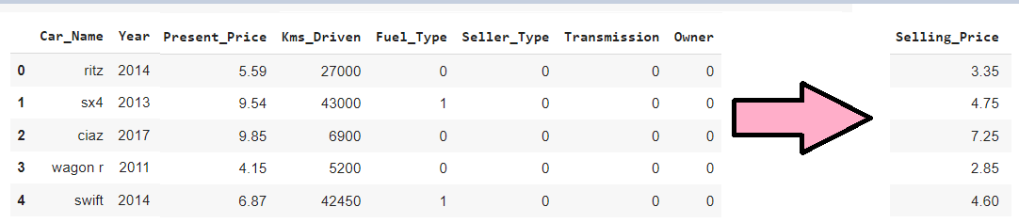
Regression (Predict Quantity)

Slide 5
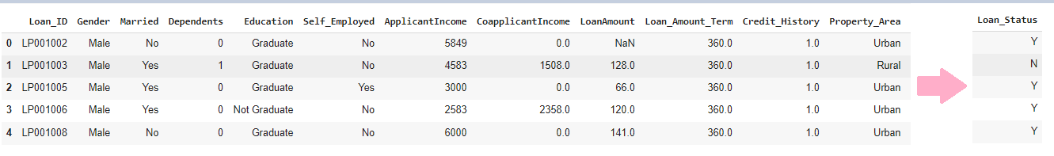
Classification (Predict Category)

Slide 6
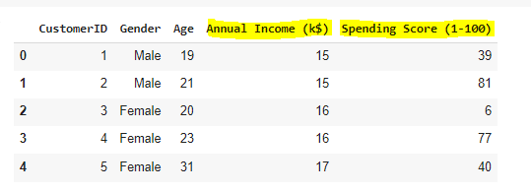
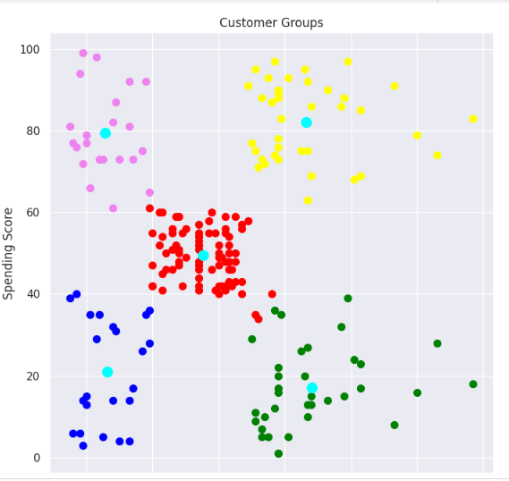
Clustering (create group of similar data )

Slide 7
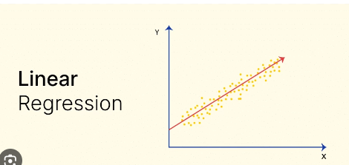
Regression Models (Linear Regression)

Slide 8
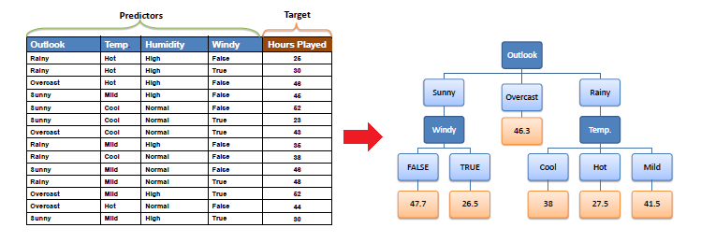
Regression Models (Decision Tree Regression)

Slide 9
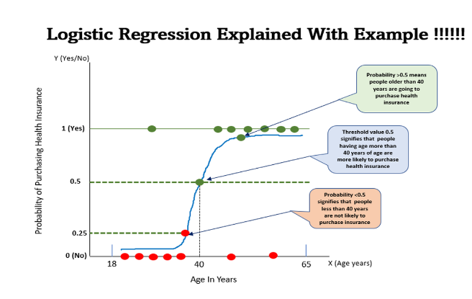
Classification Models (Logistic Regression)

Slide 10
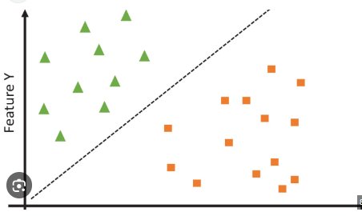
Classification Models (Support Vector Machine)

Slide 11
Clustering Models ( K Means)

Slide 12
Key Takeaways
Machine Learning problems are of three types
Regression : to predict target value
Classification : to predict target class
Clustering : to create group of similar data together
Regression Models : Linear regressor , Decision Tree Regressor
Classification Models : Support Vector Machine, Logistic Regressor
Clustering : K Means

